Slide 1

Albert Bausili, Noa Yu Ventura, Ferran Solanes

Slide 2
Our Bussiness model
Brokerage model:
“Brokers are market-makers: they bring buyers and sellers together and facilitate transactions.”
Reasons:
Our main source of income will be a fee in all user-user transactions.
For the corporation to user transactions we will charge extra money.
We will also charge the corporations/users money in order to have their products more “visible” than other products.

Slide 3
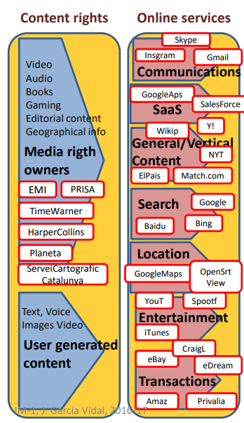
Our place in the Internet chain
Content Rights: User and enterprise generated content
Online Services:
Transactions: We connect users to enable them to safely sell/buy clothes.
Search: It is possible to search an specific type of cloth according their tags.
Communications: Users will be able to chat and make an agreement on price/sell conditions.

Slide 4
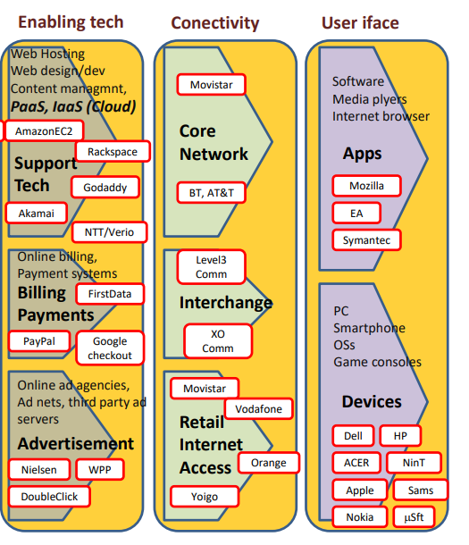
Our place in the Internet chain
Enabling tech
Support tech: We will use 2 AI models(recommendation system and body detection) and firebase hosting.
Billing Payments: Google pay, paypal and and credit/debit card payment.
Connectivity: Our server will be connected to Movistar as our ISP
User Interface
Apps: Software and a web-app.

